Slide 1
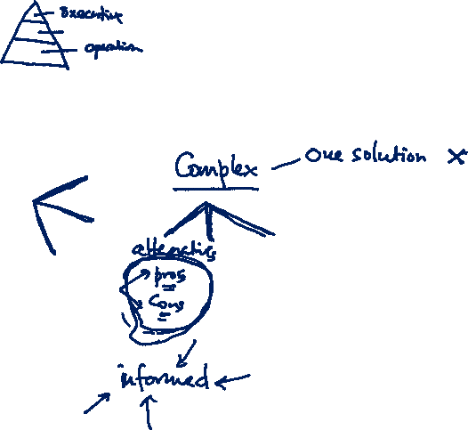
Decision making
Prof. Koliya Pulasinghe

Slide 2

Aim of the Lecture
What is the aim?
Aim of the lecture is
to provide teams with
theoretical frameworks,
strategies and
tools
that they can be used when they are making decisions.

Slide 3

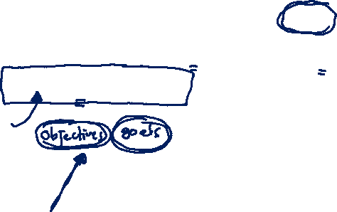
Decision
Decision –
"the act of making up your mind about something, or a position or opinion or judgment reached after consideration"

Slide 4
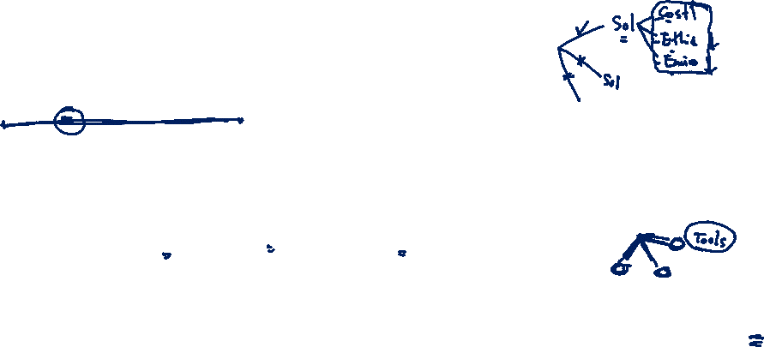
Decision Making
The cognitive process of reaching a decision.
A position or opinion or judgment reached after consideration
Choosing between alternative courses of action using cognitive processes - memory, thinking, evaluation, etc.
The Process of mapping the likely consequences of decisions, working out the importance of individual factors, and choosing the best course of action to take
In a Team ;
Process through which team selecting alternatives which are important for Team Performance

Slide 5
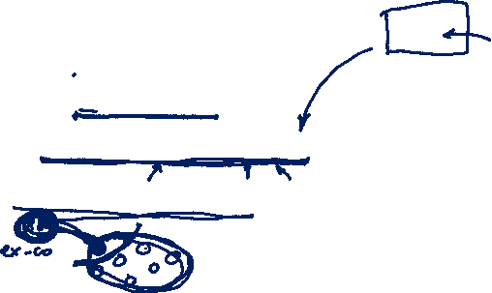
Decision Making
Why we need to learn this?
To make informed choices in team decision making processes
To get everyone involved in the decision-making process
To justify your decisions to different audiences

Slide 6

Decision Making is a Logical and Systematic Process
Create a constructive environment - (Goal/Right People/Opinions)
Generate good alternatives - (Ideas/Different Perspectives/Organize Ideas)
Explore these alternatives - (Risks/Impacts/Validations)
Choose the best alternative - (Grid Analysis/Decision Trees)
Check your decision.
Test assumptions & Decisions with own Experience
Check for Common Decision Making Problems
Check the Logical Structure of the Decision
Communicate your decision, and take action

Slide 7

Decision making
Three main areas that support systematic process are:
1. Environments for decision making
2. Methods for decision making
3. Tools for decision making

Slide 8

Environments for Decision Making

Slide 9

Features of a Thinking Environment
Attention
- listening with respect, interest and fascination to your team members
Incisive Questions
- removing assumptions that limit ideas
Equality
- treating each team member as a thinking peer
Appreciation
- practicing a 5:1 ration of appreciation to criticism of your teammates and their ideas
Ease
- ease creates. Urgency destroys

Slide 10
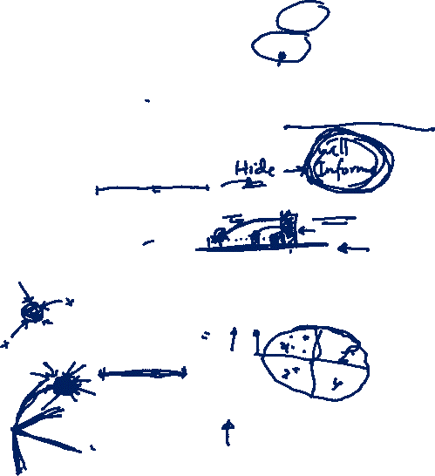
Features of a Thinking Environment
Encouragement
- moving beyond competition with your teammates to collaboration
Feelings
- allowing sufficient emotional release to restore thinking
Information
- providing a fuller, more accurate picture of reality
Place
- creating a physical environment that says ‘You matter
Diversity
- adding quality because of the differences between participants

Slide 11
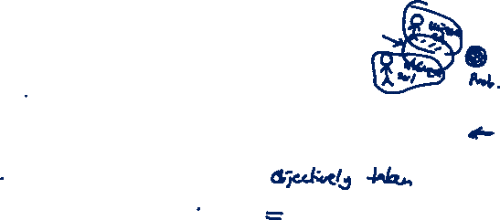
Methods for Decision Making
Understanding the decision-making methods will help you to make the best decision available.
Best Decision
would not have been thought of by an individual alone
a sound solution to the problem
a decision based upon input, as unbiased as possible, from each team member
addresses the team’s goal for the decision-making process.
Methods describe how we work, how they affect and manipulate the team decision making process in productive ways.

Slide 12

Methods of Decision Making
1. Decision by consensus
Time available allows a consensus to be reached; the team is sufficiently skilled to reach a consensus; the team commitment required to implement the decision is high.
2. Decision by majority vote
Time constraints require decision; group consensus supporting voting process; team commitment required to implement decision is moderately high.
3. Decision by minority vote (EXCO)
Limited time prevents convening entire team; clear choice of minority group; team commitment required to implement the decision is moderately low

Slide 13

Methods of Decision Making
4. Decision made by authority after group discussion
Available time allows team interaction but not agreement; clear consensus on authority; team commitment required to implement decision is moderately low.
5. Decision by averaging individuals’ opinions
Time available for decision is limited; team participation is required, but lengthy interaction is undesirable; team commitment required to implement the decision is low.
6. Decision by expert
Highly dependent on specific expertise, clear choice for expert
7. Decision made by authority without group discussion
Simple, routine, administrative decisions; little time available to make decision;

Slide 14

Tools for Decision Making
Why we need tools?
In addition to creating an environment for effective decision making and using methods for making decisions as a team, tools can assist teams in formulating and reaching decisions.

Slide 15


Tools to assist teams for Decision Making
Brainstorming
Brainstorming is a group creativity technique by which efforts are made to find a conclusion for a specific problem by gathering a list of ideas spontaneously contributed by its members
Wikipedia

Slide 16
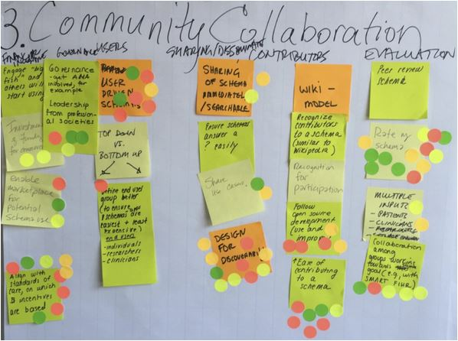
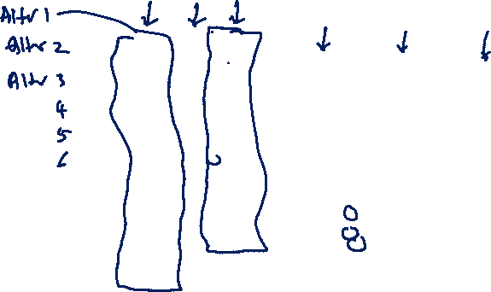
Tools to assist teams for Decision Making
Affinity Grouping
Grouping unstructured ideas (Generated from Brainstorming) based on their natural relationship

Slide 17
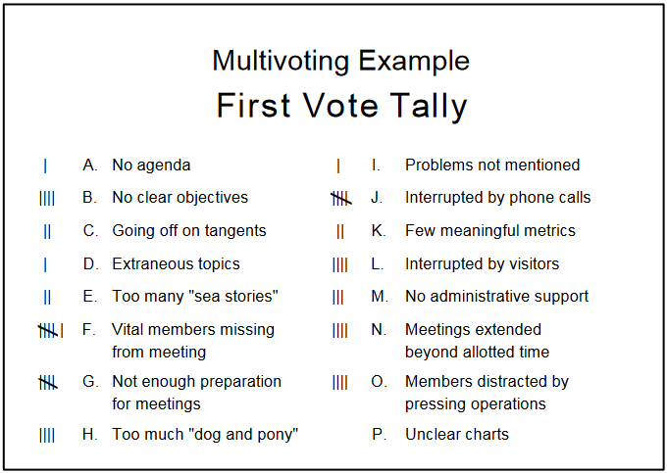


Tools to assist teams for Decision Making
Multi-voting
The multi-voting technique holds an answer to your problems when decision making becomes tough, because of too many options/alternatives.
Process: Each member is given many votes (Ex: 1/3 of the options), Run it many rounds.

Slide 18
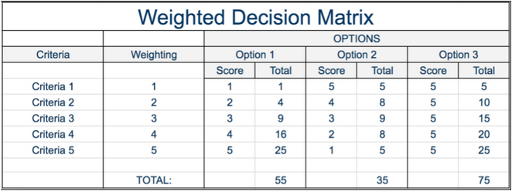
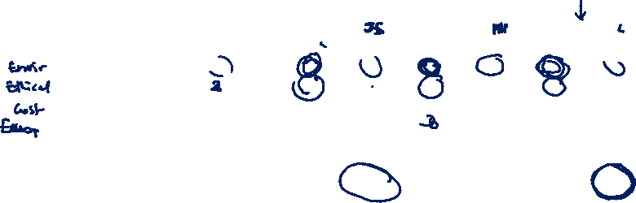
Tools to assist teams for Decision Making
Criteria Matrix
A decision matrix is a list of values in rows and columns that allows an analyst to systematically identify, analyze, and rate the performance of relationships between sets of values and information. Elements of a decision matrix show decisions based on certain decision criteria.
Wikipedia

Slide 19
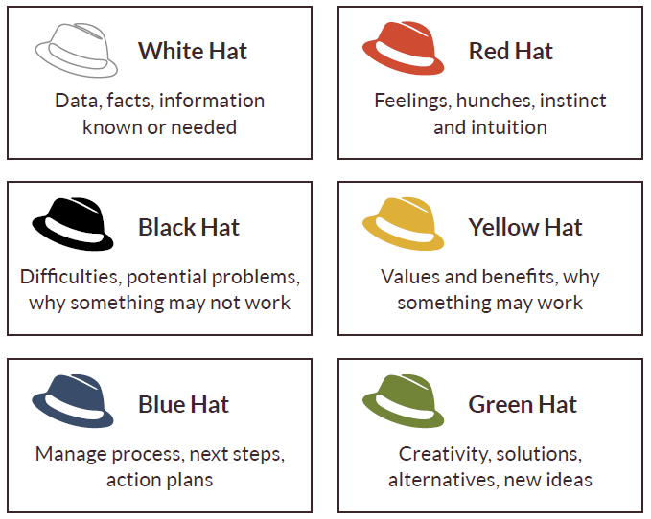
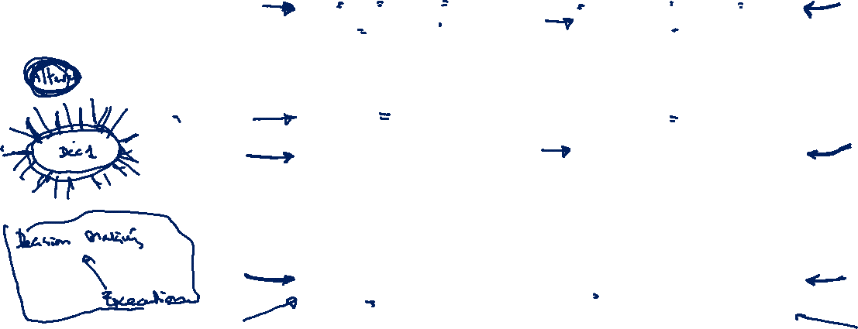
Tools to assist teams for Decision Making
Six Thinking Hats:
Looking at a decision from a range of different perspectives

Slide 20

Important issues of Decisions
Every Decision must address two issues:
1. Merit Dimension – Merits of the decision in some quantitative way
2. Acceptance Dimension – People affected by the decision will accept it

Slide 21

DM in Project Teams (continue...)
Advantages of Team Decision Making
Greater Knowledge: because of the number of people involved, each with differing experience, knowledge, points of view and values, a larger number and variety of ideas for solving a problem can be produced.
Shared responsibility: makes individuals more willing to take risks. The discussion of different points of view also helps the group to be more realistic in assessing the risks associated with particular courses of action.
Higher commitment: individuals who have contributed to finding a solution feel a greater commitment to its successful implementation.

Slide 22
DM in Project Teams (continue...)
Weak Points of Team Decision Making
Time consumption: group problem solving is a relatively slow process compared with working alone.
Less recognition: identifying who really did his/her best is difficult to recognize as it is a collaborative effort thus, less chance for recognition for promotion
Conformity: there is a strong tendency for individuals in a group to want to conform to the consensus. This can be due to a variety of reasons, including the need to feel valued or respected.

Slide 23
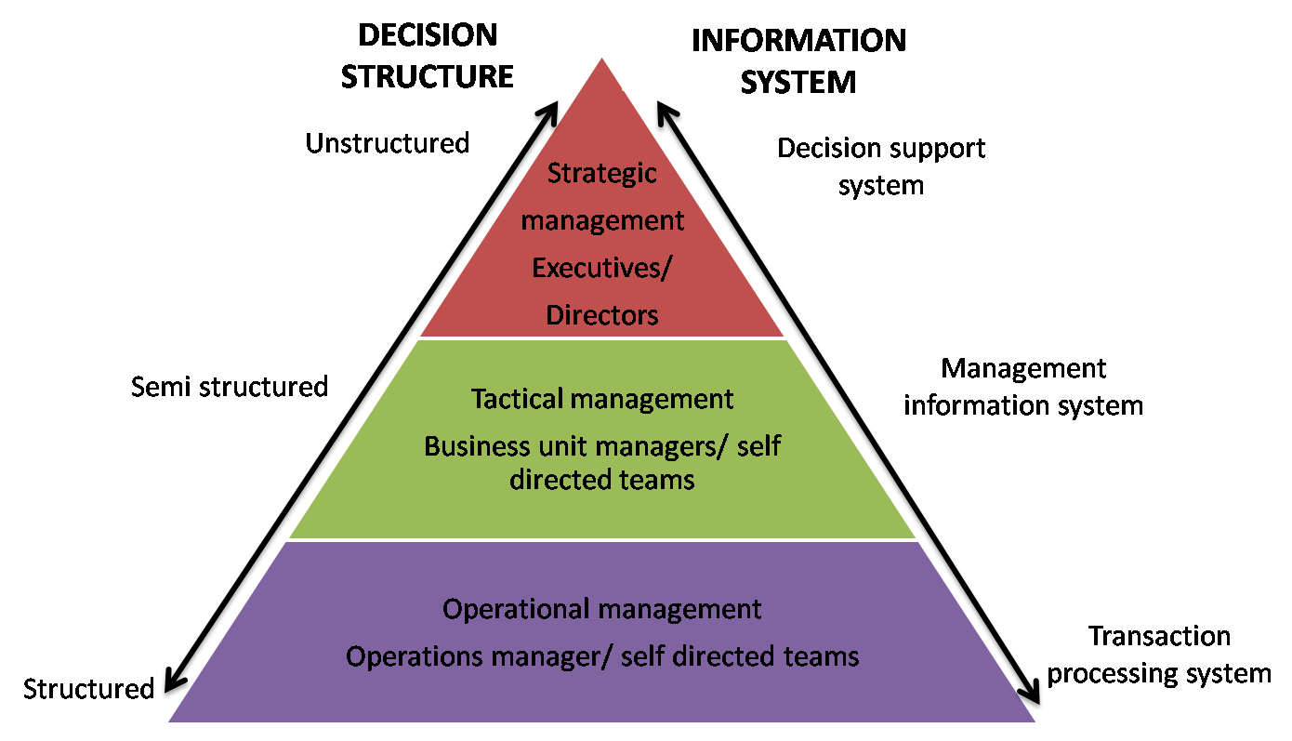

Decision Making and Information Systems

Slide 24

Exercise:
Have a group discussion with your ITP team members about what tools you have already used when you decide on technology/technologies to implement ITP Project.
Write a reflective journal about one of the decisions you have made in academic life. Discuss what tools you have used to make that decision. If you face the same situation, discuss how this lecture would help you.
Submit your assignment on or before midnight 21st August, 2021.

